Slide 1
How To Be Healthy
Jialong Li

Slide 2
3 Steps
Having a Healthy
Exercise Plan
Maintain a healthy weight
Get in shape
Exercise wisely
Having a Healthy Diet
Having a
Healthy Routine
Drink more water
Eat at the right times
Limit simple sugars in your diet
Create a daily routine
Stop engaging in risky behavior
Maintain your personal hygiene.

Slide 3
Having a Healthy Diet

Slide 4
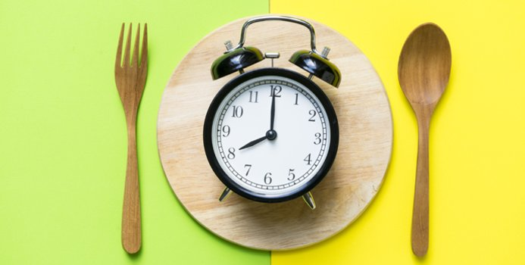
Drink more water
Eat at the right times
Limit sugars in your diet

Slide 5
Having a Healthy
Exercise Plan

Slide 6
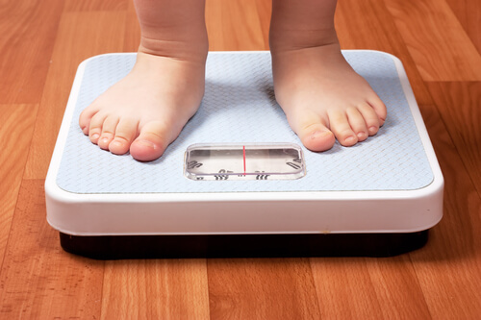
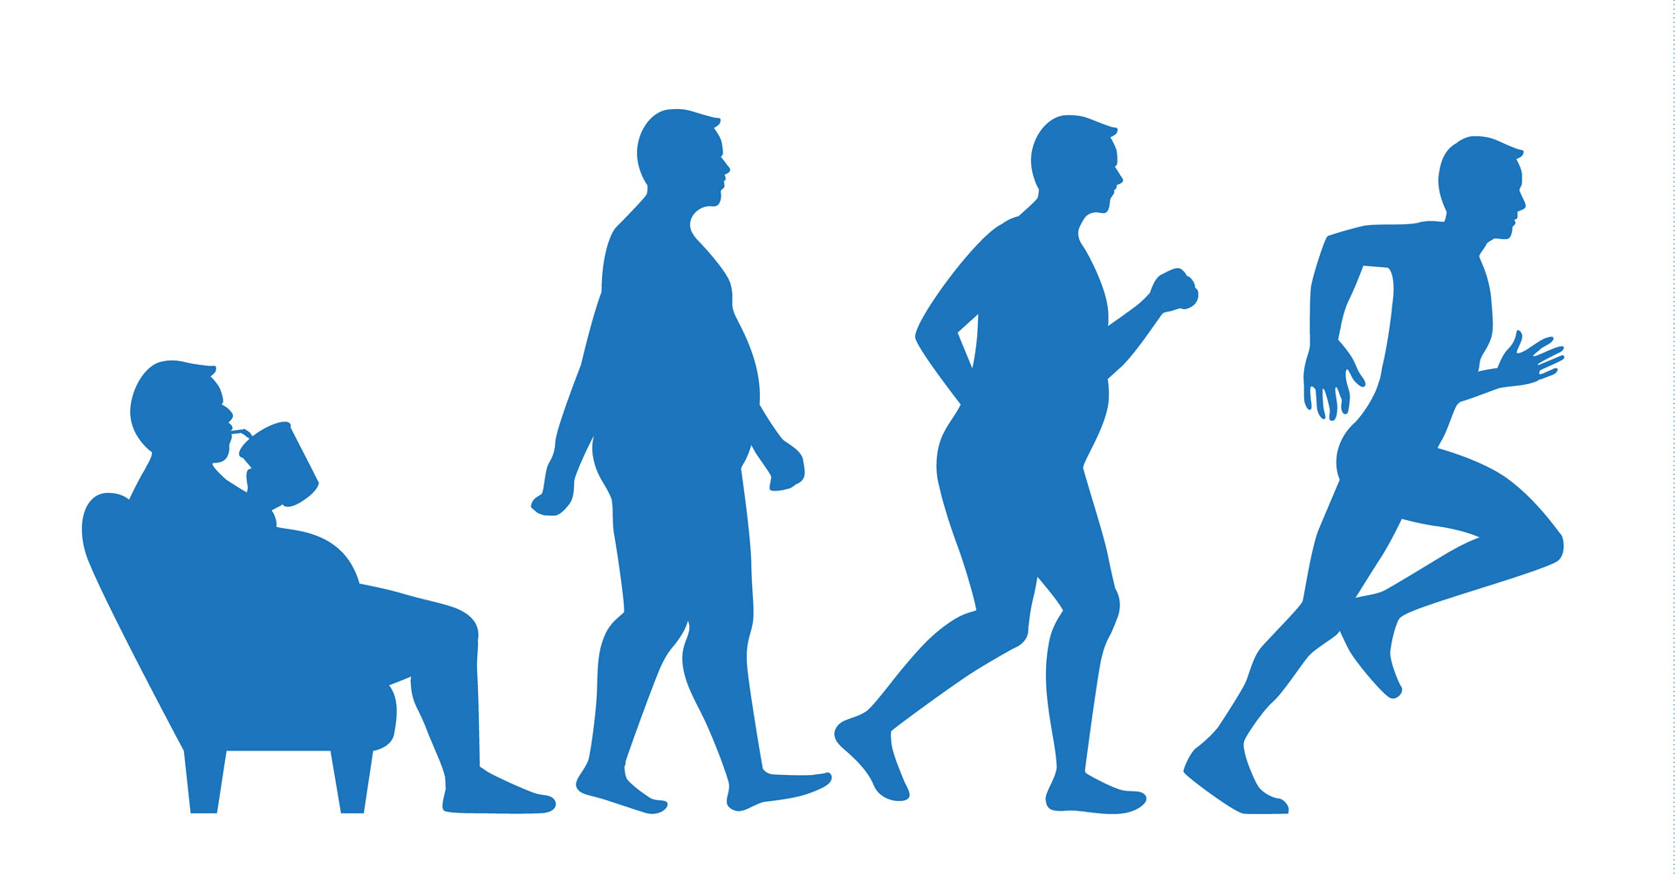
Maintain a healthy weight
Get In Shape
Exercise wisely

Slide 7
Having a Healthy Routine

Slide 8
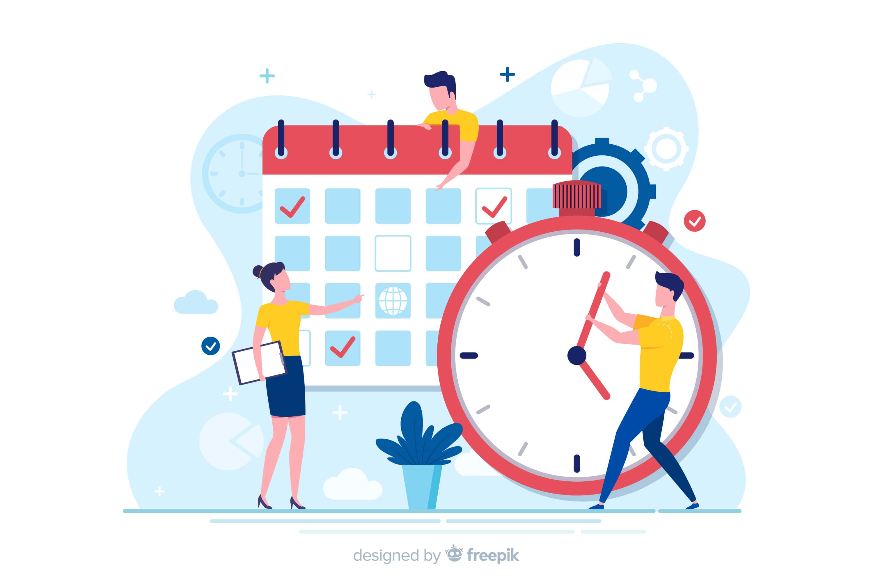
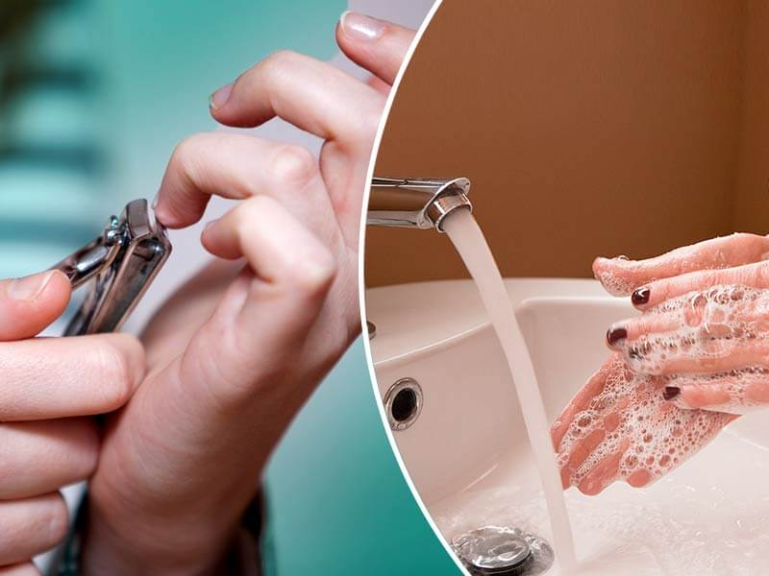
Create a daily routine
Stop engaging in
risky behavior
Maintain your personal hygiene.

Slide 9
Summary
Having a Healthy Diet
Having a Healthy Exercise Plan
Having a Healthy Routine

Slide 10
See
THANK YOU
U
JIalong Li

