Slide 1
How To Be Healthy
Jialong Li

Slide 2
3 Steps
Having a Healthy
Exercise Plan
Maintain a healthy weight
Get in shape
Exercise wisely
Having a Healthy Diet
Having a
Healthy Routine
Drink more water
Eat at the right times
Limit simple sugars in your diet
Create a daily routine
Stop engaging in risky behavior
Maintain your personal hygiene.

Slide 3
Having a Healthy Diet

Slide 4
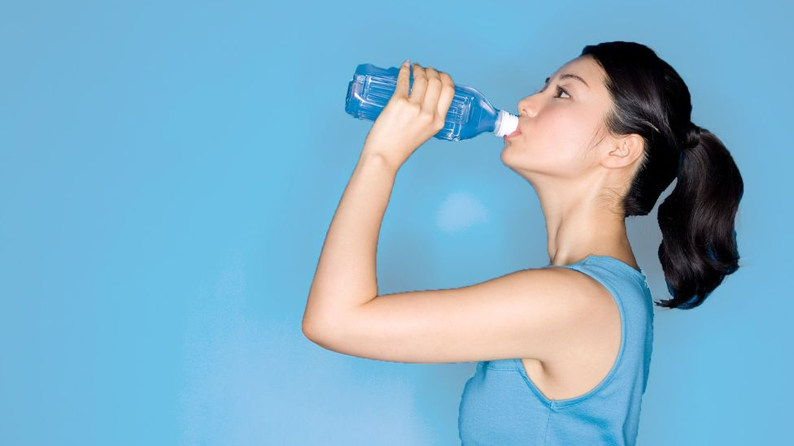
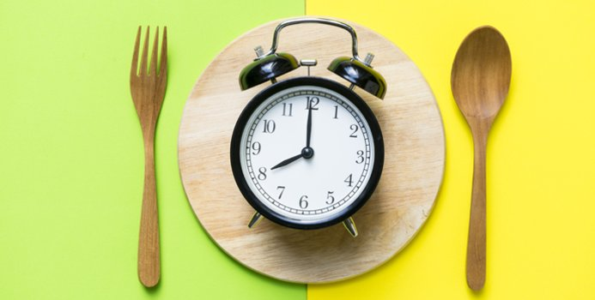
Drink more water
Eat at the right times
Limit sugars in your diet
Water supports health and promotes hydration without adding calories to the diet.
Eat less and more meals. Eat at least three meals a day, with snacks in between.
Avoid sugary drinks and drink water instead. Low-fat, unsweetened milk is also a good way to stay hydrated.

Slide 5
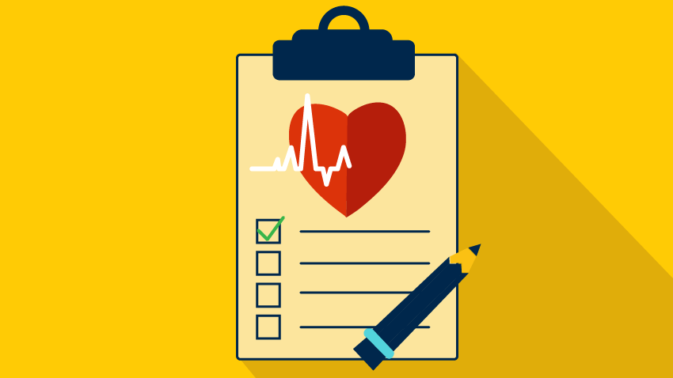
Benefit
A healthy diet can help reduce the risk of heart disease and stroke by
Improving your cholesterol levels
Lowering your blood pressure
Helping you manage your weight
Controlling your blood sugar.

Slide 6
Balanced diet

Slide 7
Having a Healthy
Exercise Plan

Slide 8
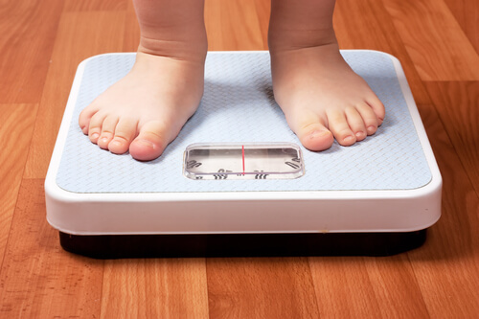
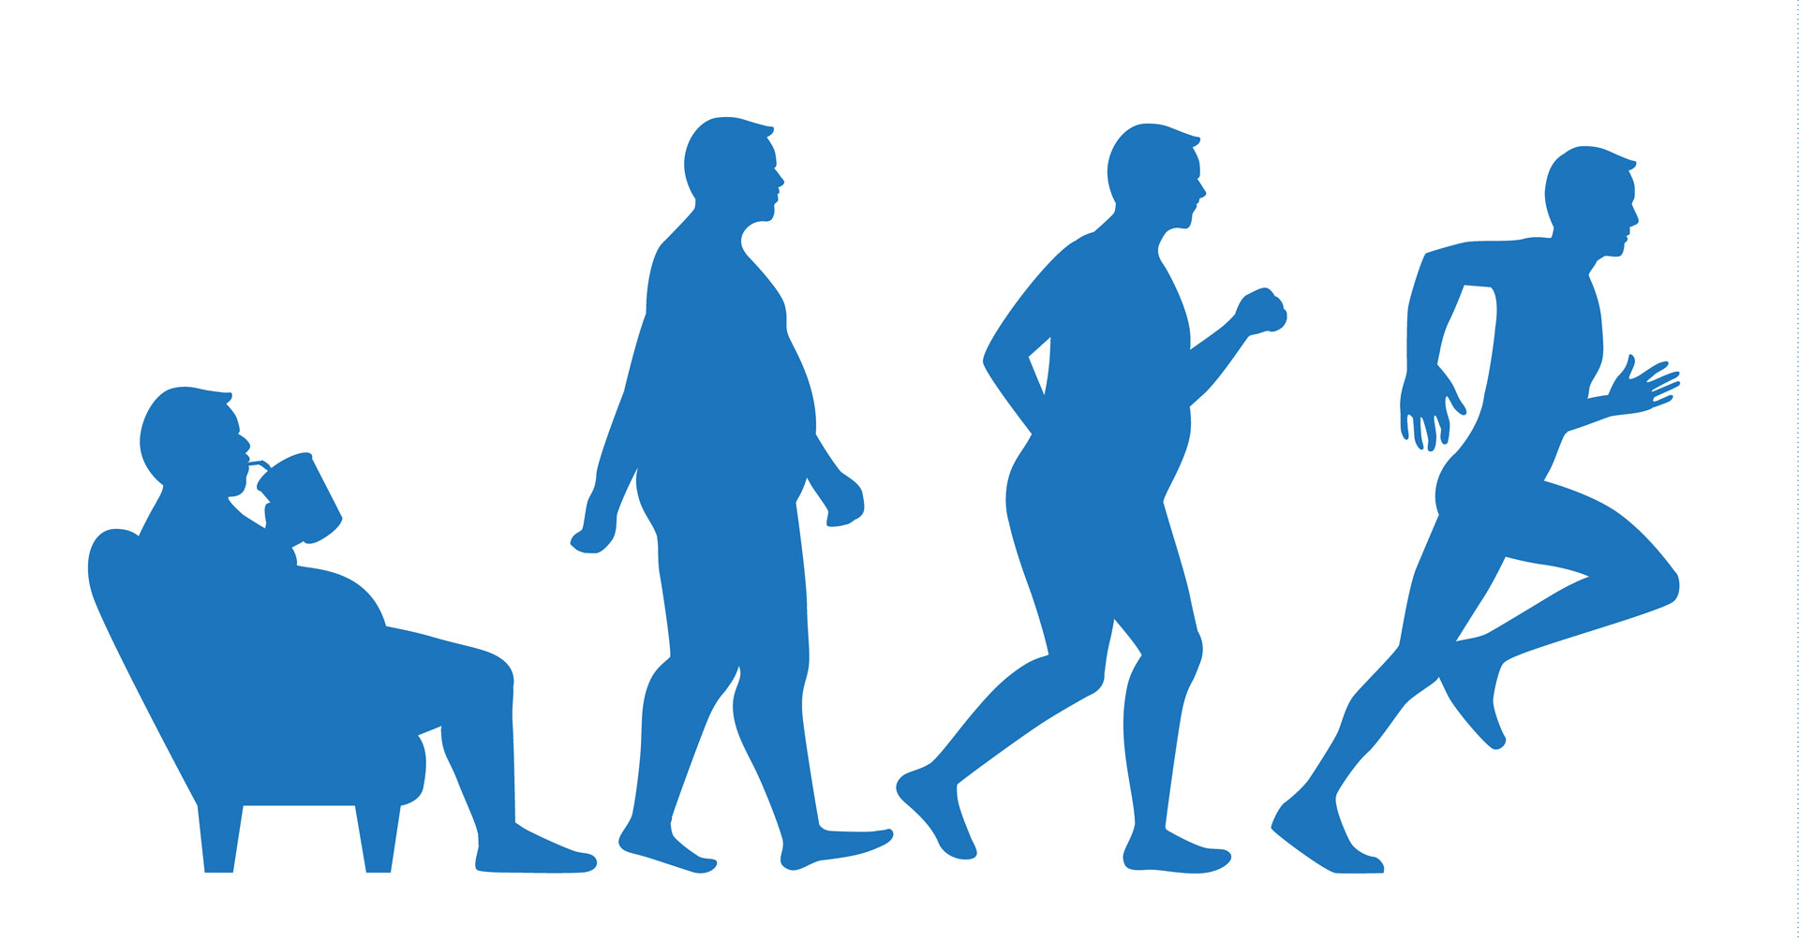
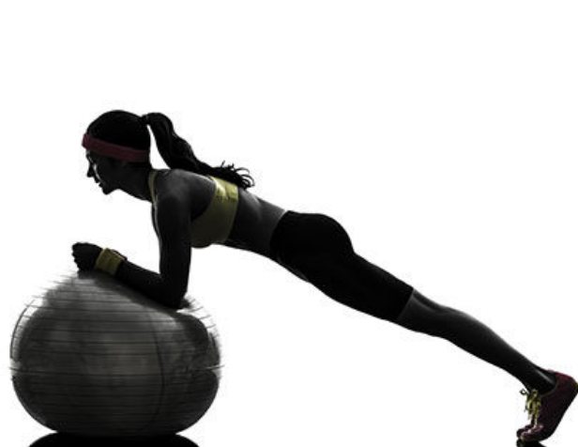
Maintain a healthy weight
Get In Shape
Exercise wisely
Warm up first. Warmer muscles are more flexible. Warm up for 5 to 10 minutes first, or save the stretching for your cool-down routine after your workout.
Often referred to as aerobic or endurance exercise, aerobic exercise is great for burning calories and losing excess fat.
Activities such as yoga combine stretching and relaxation with the added benefit of improved balance - a wonderful combination.

Slide 9
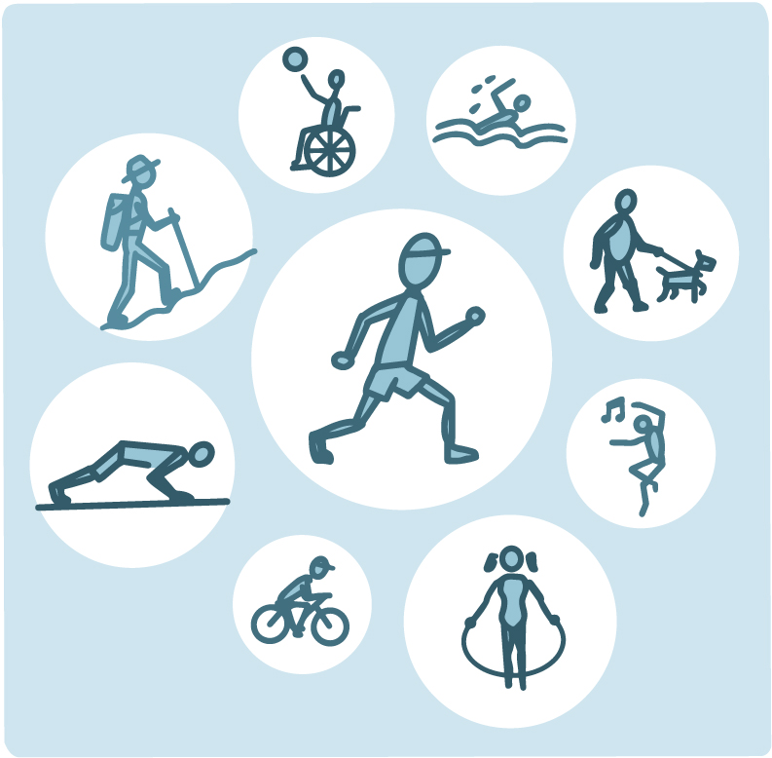
Aerobic activity
Walking
Jogging
Biking
Swimming
Dancing
Water aerobics

Slide 10
What happens inside your body when you exercise?

Slide 11
Having a Healthy Routine

Slide 12
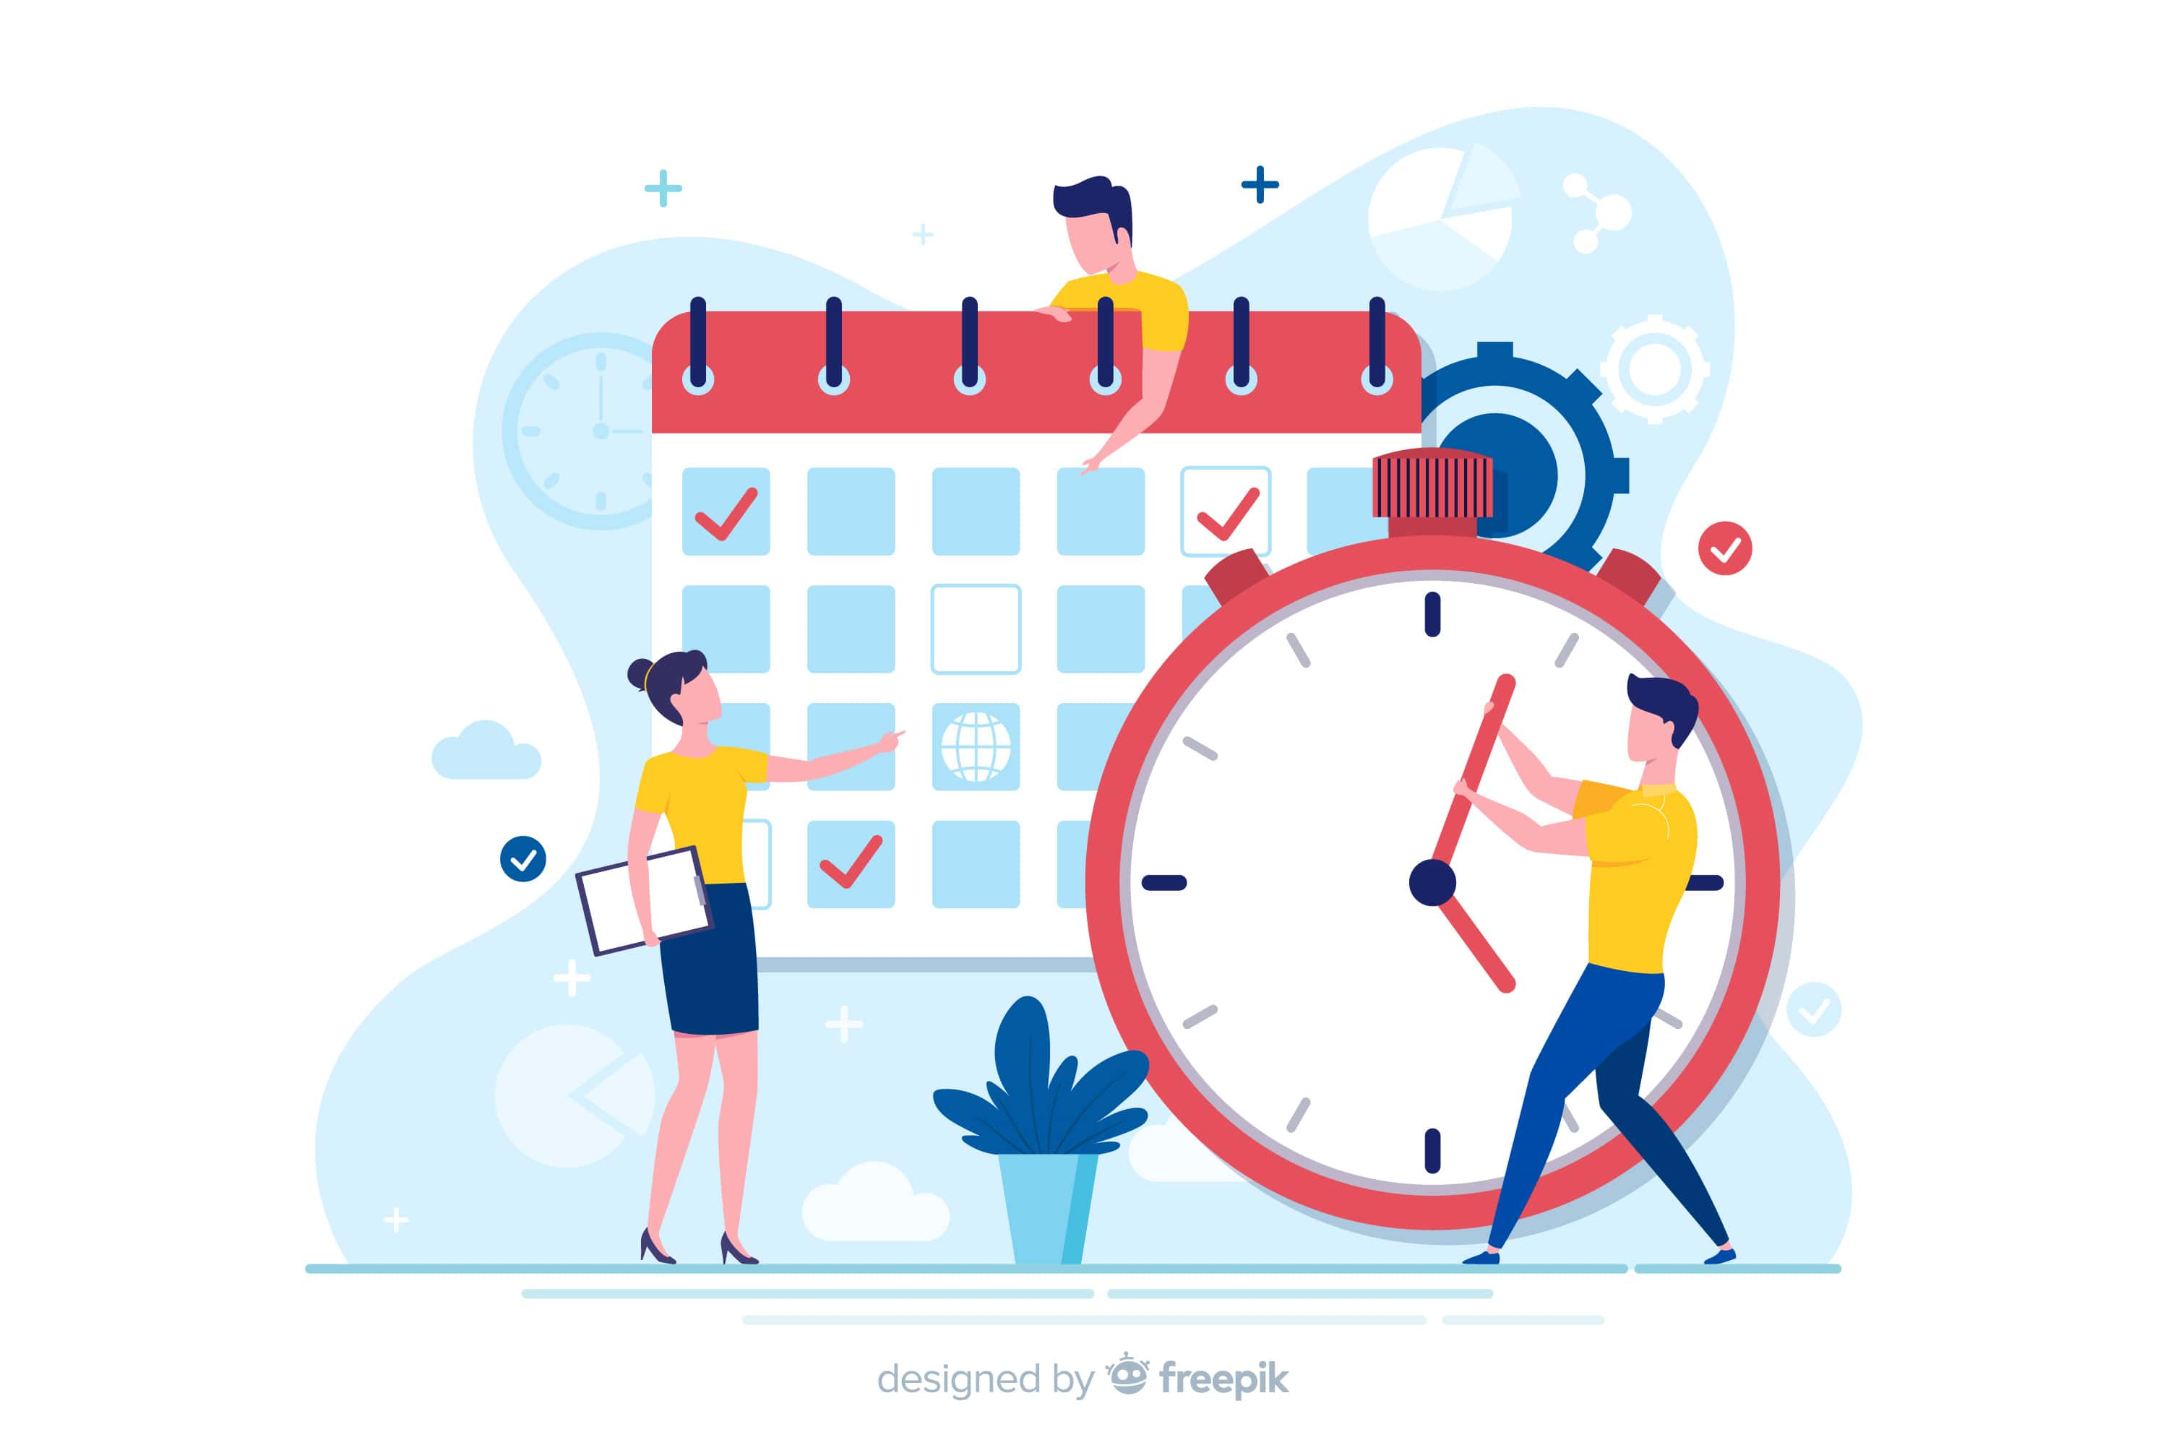
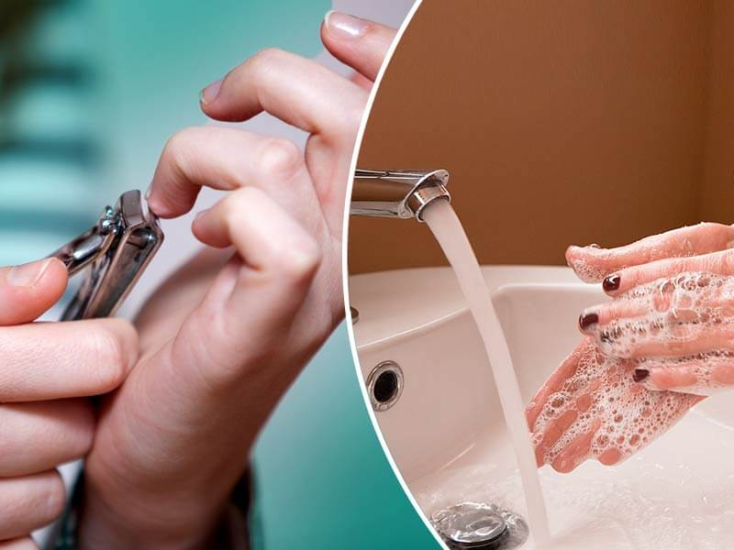
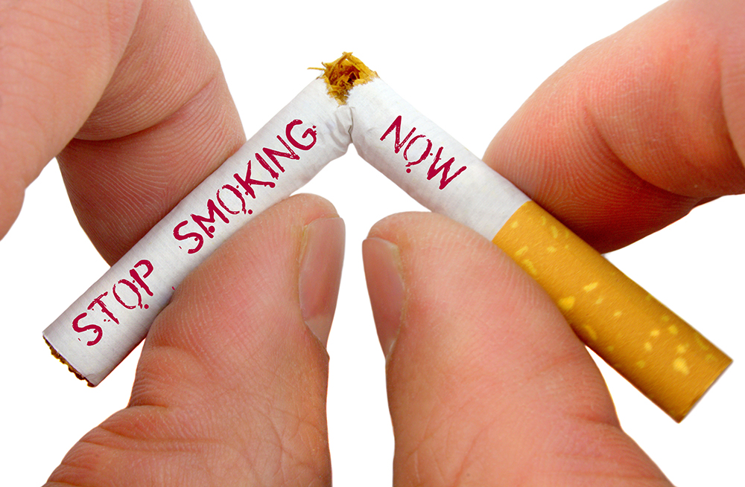
Create a daily routine
Stop engaging in
risky behavior
Maintain your personal hygiene.
Finding and adopting the right daily routine will rejuvenate you and your mind and body will thank you for reducing anxiety and giving them extra care.
One of the best ways to maintain good overall health is to maintain proper personal hygiene. Personal hygiene helps you stay clean, boosts your confidence and positively influences relationships, and reduces the risk of illness and negative medical conditions that can result from poor hygiene.
Risky behavior may cause you physical harm, lead you to contract sexually transmitted infections, etc.

Slide 13
Anatomy of a Perfect Morning Routine

Slide 14
Summary
Having a Healthy Diet
Having a Healthy Exercise Plan
Having a Healthy Routine

Slide 15
Reference
https://www.youtube.com/watch?v=NqV1Ig4_nfI
https://www.youtube.com/watch?v=wWGulLAa0O0
https://www.youtube.com/watch?v=LQ8JOsc3-wU

Slide 16
See
THANK YOU
U
JIalong Li

